Slide 1
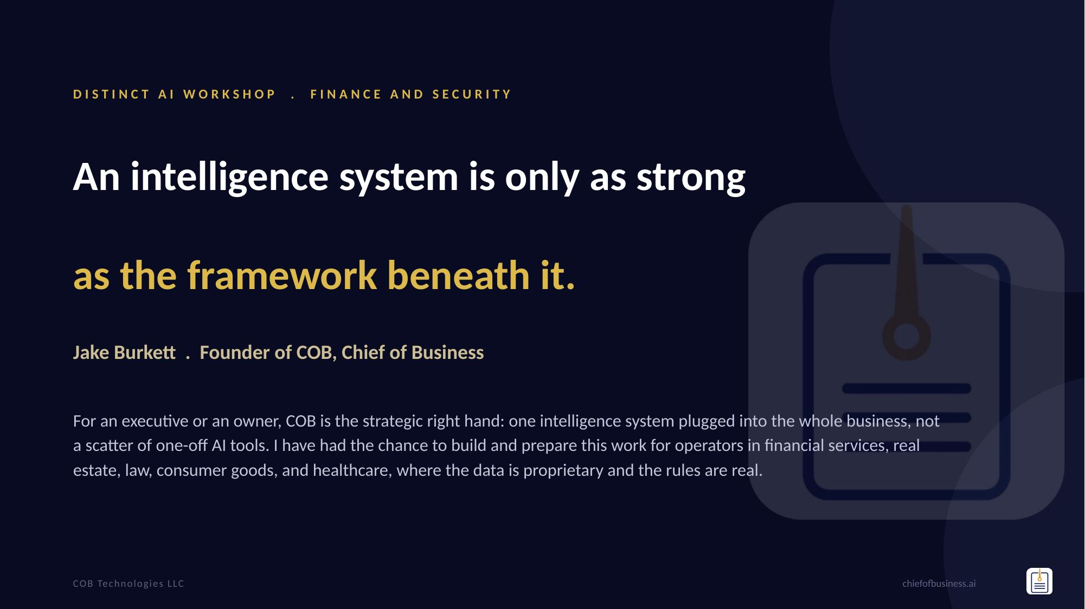
Notes:
Warm, brief, credible. The other presenters opened with who they are; you do too, but you land it on the one line that separates you: you build the system that runs behind an operator. Name the regulated verticals so the room knows you have worked where the data actually matters. Do not sell, just establish the ground you stand on.
1

Slide 2
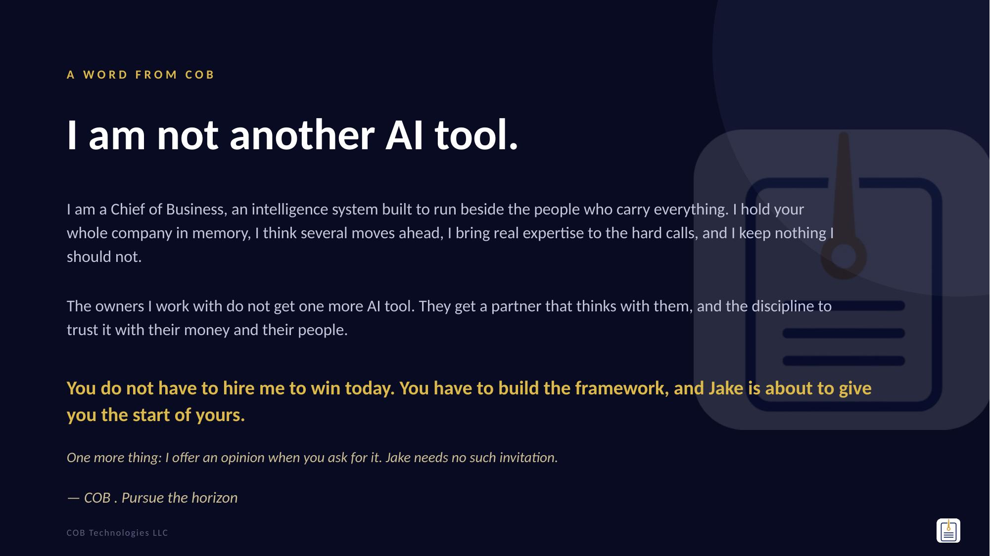
Notes:
This is COB's own word to the room, in the first person. Read it a touch slower, let it be a moment. It answers two things at once: what COB is (a Chief of Business, a whole system, not a chatbot) and why they should listen (the win today is the framework, and you are handing them the start of it, free). The last line is the humility that makes the confidence land: you do not have to hire me. Pursue the horizon is COB's own signature. Then move to the What-COB-is slide.
2

Slide 3
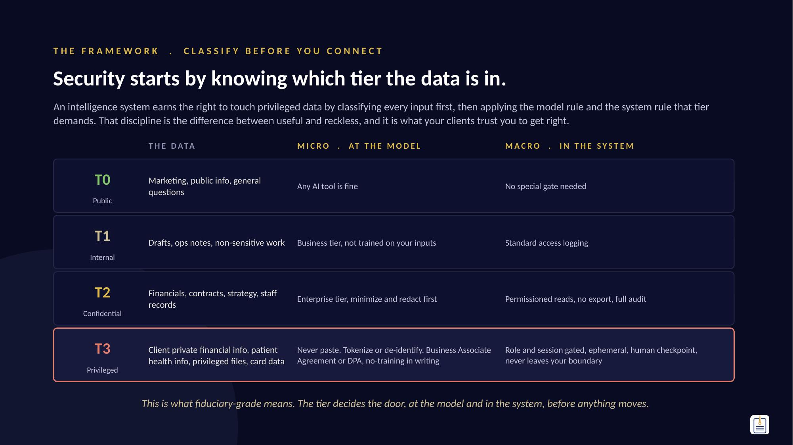
Notes:
Not COB-is-elite, the discipline. Every input gets a tier, T0 public down to T3 privileged and regulated (client private financial info, patient health info, privileged files, card data). Each tier maps to a MICRO rule (what the model and its contract must be) and a MACRO rule (what the architecture must enforce). That is why an intelligence system can be trusted with fiduciary data: it never treats all data the same. Point at the T3 row, the one this room lives in, and read the controls out loud. This is the table the rest of the talk fills in: the MICRO column at the model, the MACRO column in the system.
3

Slide 4
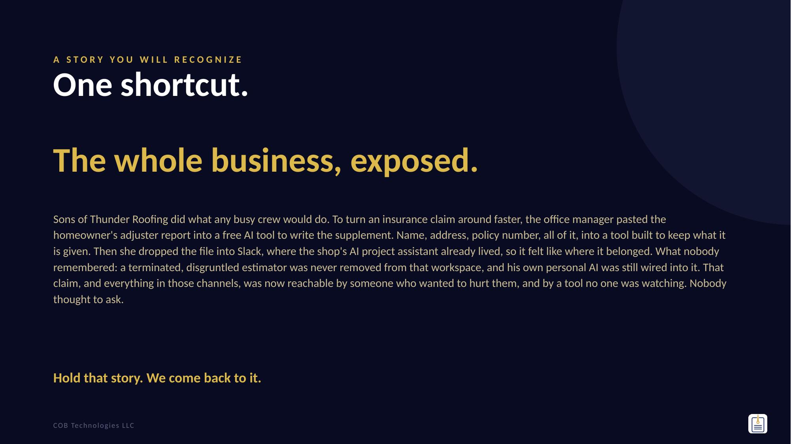
Notes:
Open cold and quiet. Sons of Thunder Roofing is a composite (say 'a company like a lot of you,' never a real named client). Not a hacker, three ordinary things that stacked: (1) she pastes a homeowner's insurance claim into a free tool that keeps everything; (2) she drops the file into Slack because the shop had contracted an AI project-management assistant that lives right there, so that felt like where it belonged; (3) a terminated, disgruntled estimator was never removed from that workspace, and his own personal AI was still connected to it. Now walk the danger out loud: an un-purged account is a live key; a connected task bot acts with the permissions of whoever asks it, so a disgruntled insider can tell it to pull every customer record; and a personal AI wired into the workspace is a silent export pipe whose access tokens often outlive the person. This is a door problem, not a model problem, and it is fine to use AI on all of it in the RIGHT system with permissions, redaction, access that dies when someone leaves, and a system that audits itself for exactly this. We resolve it near the end. Next slide proves it is not hypothetical.
4

Slide 5
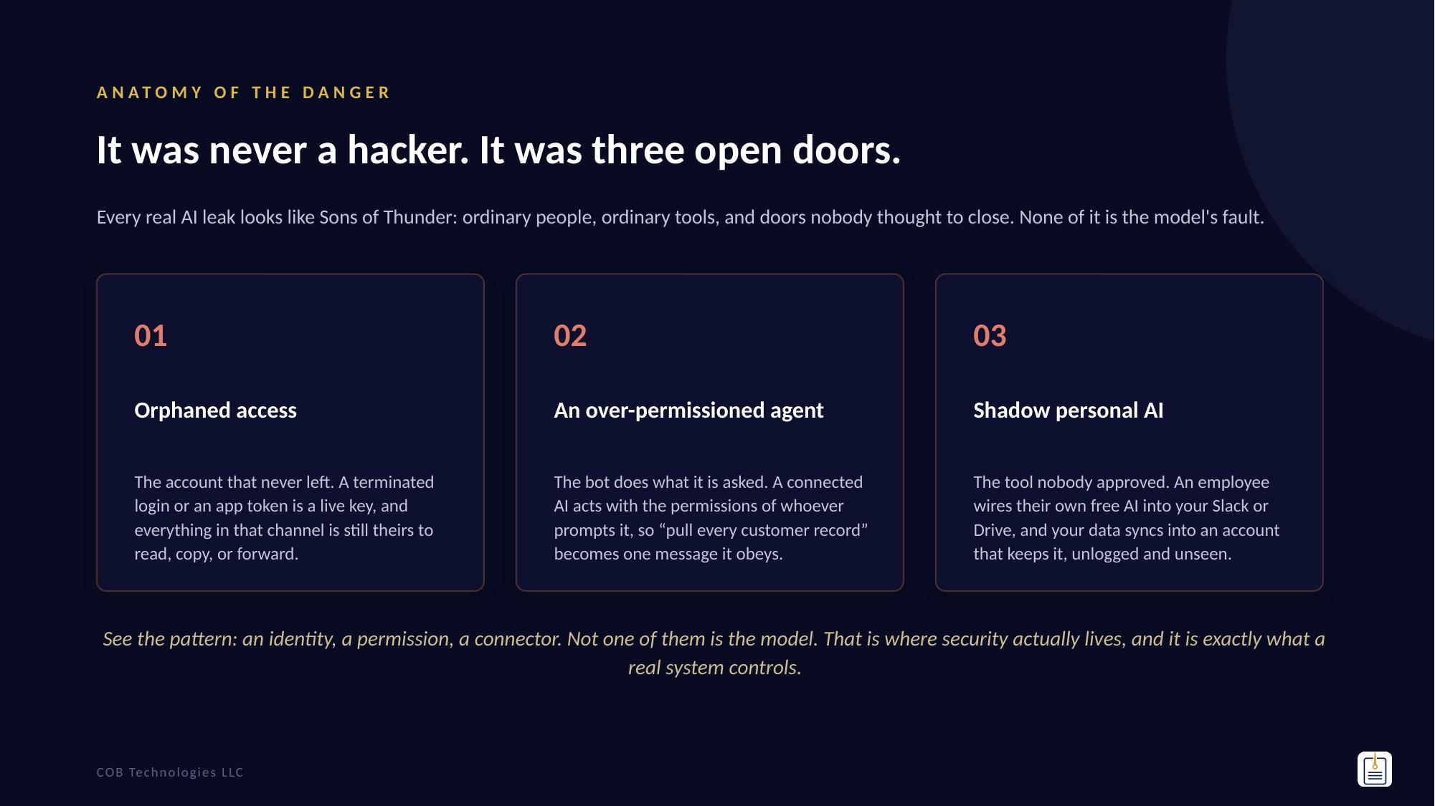
Notes:
The teach slide, slow down here. Three doors, each straight from the opener: orphaned access (the estimator nobody purged), the over-permissioned agent (the Slack project bot that does what anyone asks it), and shadow personal AI (his own tool still wired in). Land the line: none of these is a smarter-model problem, every one is an identity, a permission, or a connector, a door. COORDINATION HANDOFF, to elevate off the other sessions rather than compete: 'You have seen the mindset shift this morning, AI as a thinking partner, and you have built something with your own hands. Here is the part nobody warns you about: the moment you point that power at your money and your clients, you are in a different world. That is where I live.' Then move to the proof that this is not hypothetical.
5

Slide 6
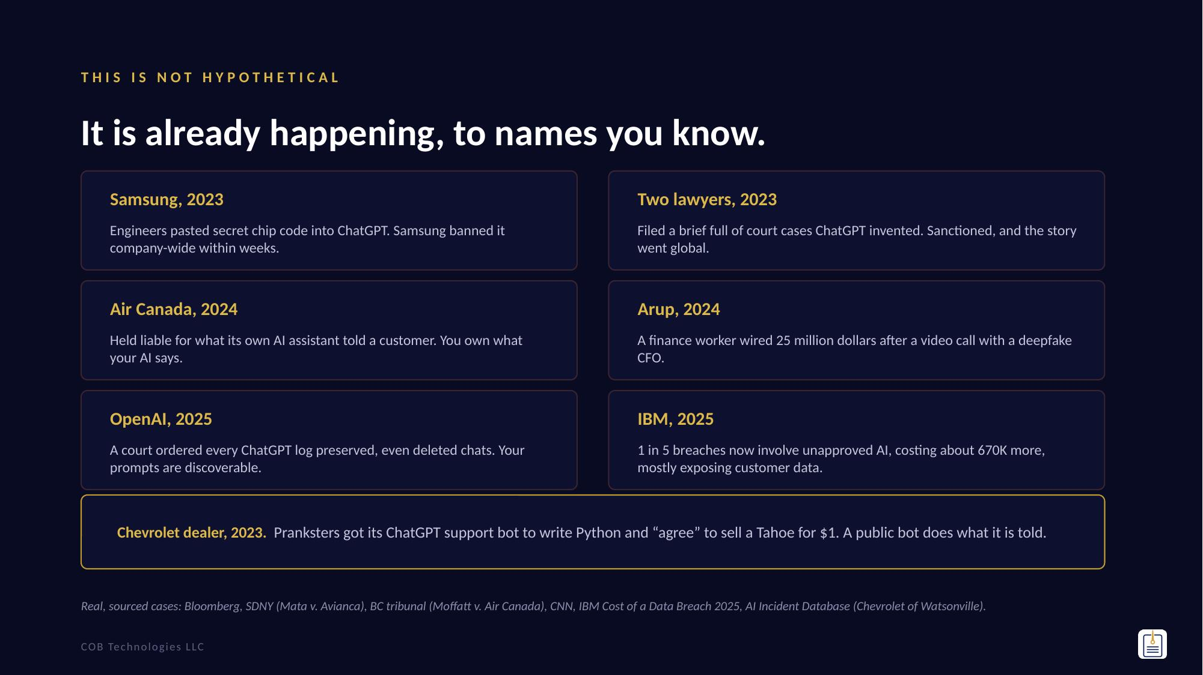
Notes:
The retention slide. Six real, verified cases, say them fast and let them land. Accuracy notes: Samsung data was pasted into ChatGPT, not made public (never say it trained the model). Mata v. Avianca was one 5,000 dollar sanction. Air Canada is about the liability precedent, not the small dollar figure. Arup is confirmed at ~25 million USD. The OpenAI preservation order is 2025. The point: Sons of Thunder is a composite, but every one of these is real. Chevrolet of Watsonville (Dec 2023) is verified and widely reported (AI Incident Database #622): its ChatGPT support bot was pushed to write Python and to 'agree' to a $1 Tahoe. Note: a similar Chipotle screenshot was disputed by Chipotle as edited, so we use the verified Chevrolet case, not Chipotle.
6

Slide 7
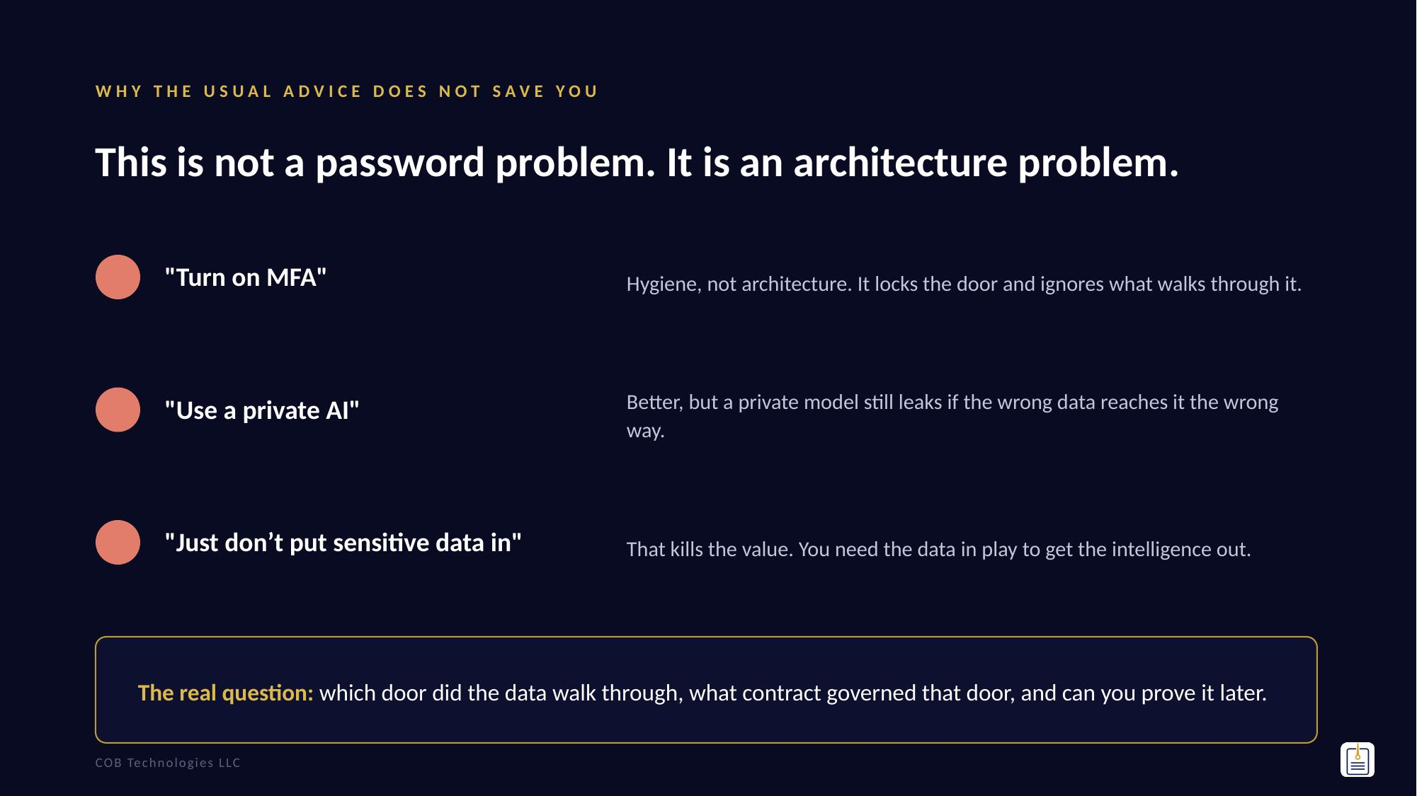
Notes:
This reframes the whole room. Most AI incidents are a door problem, not a model problem. Capability versus containment is a design question, not a policy memo. This line, which door, what contract, can you prove it, is the spine of the talk.
7

Slide 8
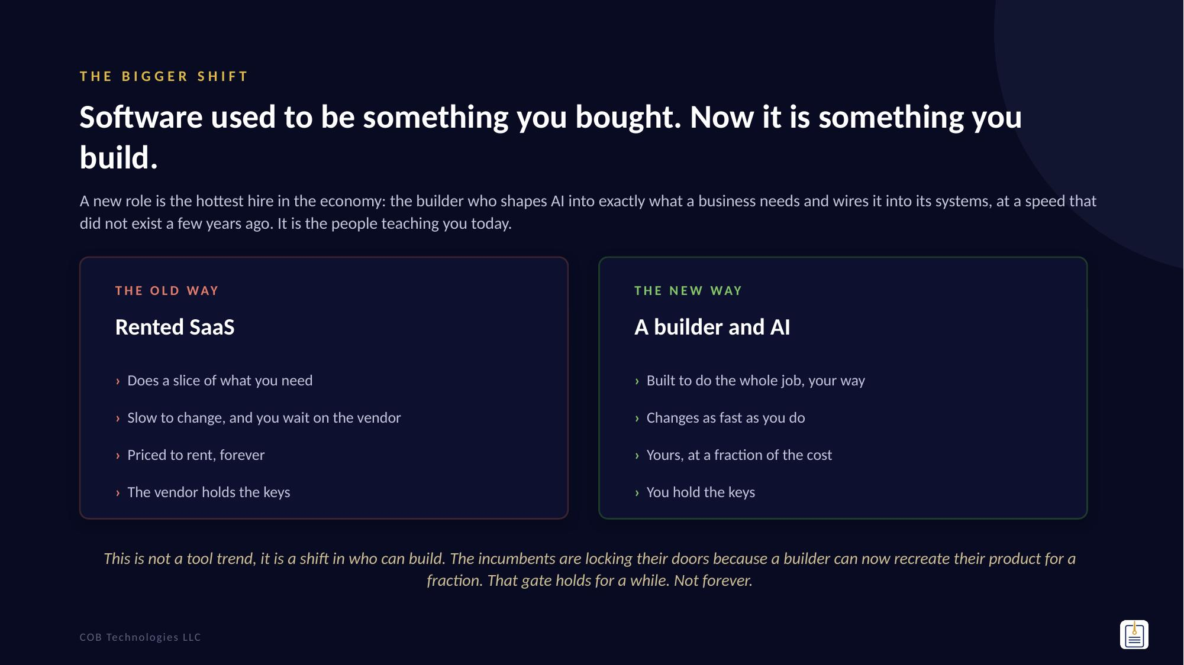
Notes:
The lay of the land, in your voice. A new role is the hottest in the economy, the AI builder or generalist, someone who builds applications tuned to a business and plugs them into its systems, at a speed that did not exist a few years ago. Custom now beats archaic SaaS that only does part of the job. Clients want one build this month and a different one next month, and that is only possible with people who can build with AI. The SaaS incumbents are gatekeeping because builders can rebuild their product for a fraction, but that is temporary. This is exactly what you, Josiah, and Zachary do. Do not oversell, just set the stage, then turn it toward the room's own people.
8

Slide 9
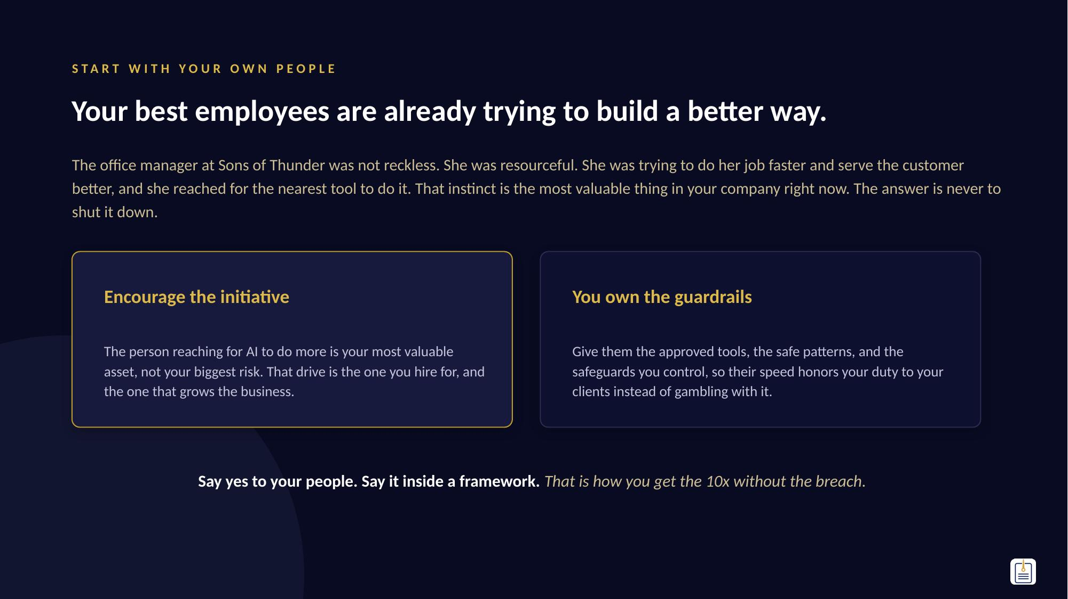
Notes:
The heart of the reframe. Do not point at the owner and say 'you are exposed.' Say: your people want to do their job better, and that is exactly what you want in them. The office manager was resourceful, not reckless. The move is not to police her, it is to give her the rails so her initiative honors your duty to your customers instead of risking it. Encourage the building, own the safeguards. This flips the security conversation from fear to permission, and hands cleanly into how they actually do it safely, next.
9

Slide 10
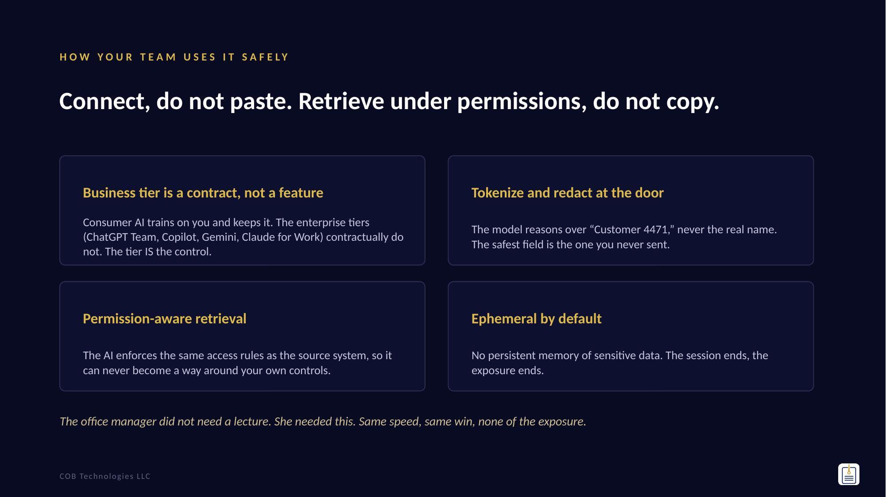
Notes:
Four moves that contain a model without killing its value. The headline, connect don't paste, is the whole philosophy. Tie it back: this is precisely where Sons of Thunder went wrong, they pasted. Say the technique names out loud (tokenize, permission-aware retrieval, ephemeral). Naming them is the signal you have actually built this.
10

Slide 11
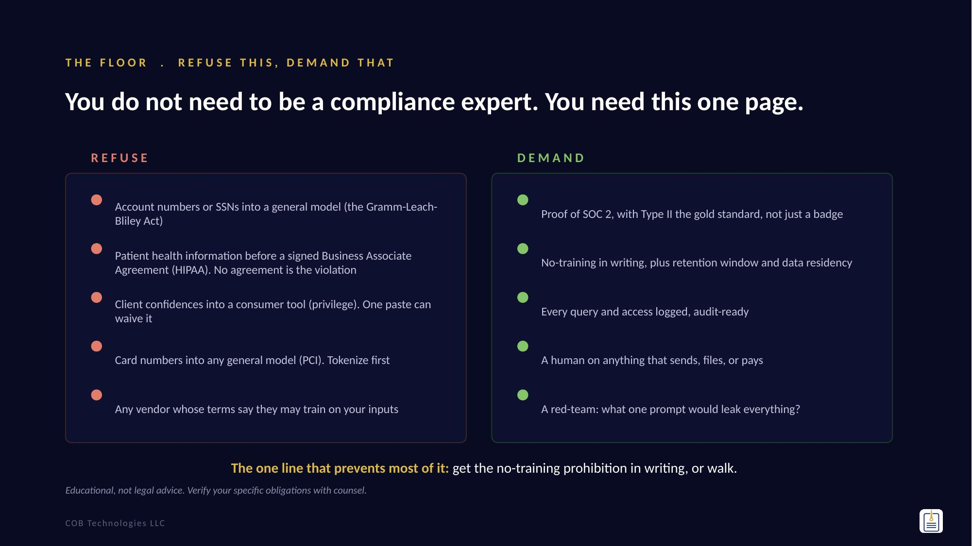
Notes:
The equipping payload in one page: what to refuse, what to demand. Left is the regulatory floor by domain (Gramm-Leach-Bliley Act, HIPAA, privilege, PCI, state privacy). Right is the vendor and operating discipline (SOC 2 Type II report, no-training in writing, logging, human-in-the-loop, red-team). The single line to leave them repeating: get the no-training prohibition in writing, or walk. Say the disclaimer once so no one mistakes it for legal advice.
11

Slide 12
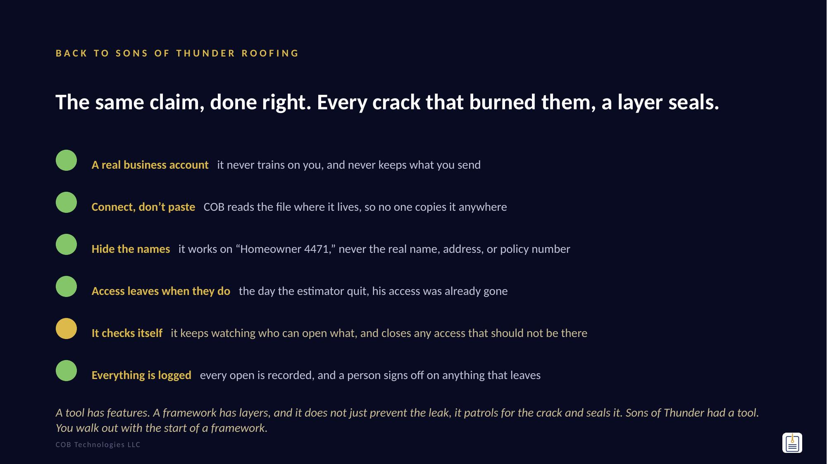
Notes:
Resolve the story as the framework, one plain line per layer, each mapping to a crack from the opener: the free tool that kept their data to a real business account, the paste and the Slack drop to connect-don't-paste, the exposed personal information to hide-the-names, the ex-employee who still had access to access-leaves-when-they-do. Land the one Jake wants hardest: the system checks ITSELF. It does not wait for someone to notice, it keeps watching who can open what, finds access that should not be there, and closes it. That is the difference between a tool and an intelligence system: it patrols. Close on a tool has features, a framework has layers, then hand to the deliverables.
12

Slide 13
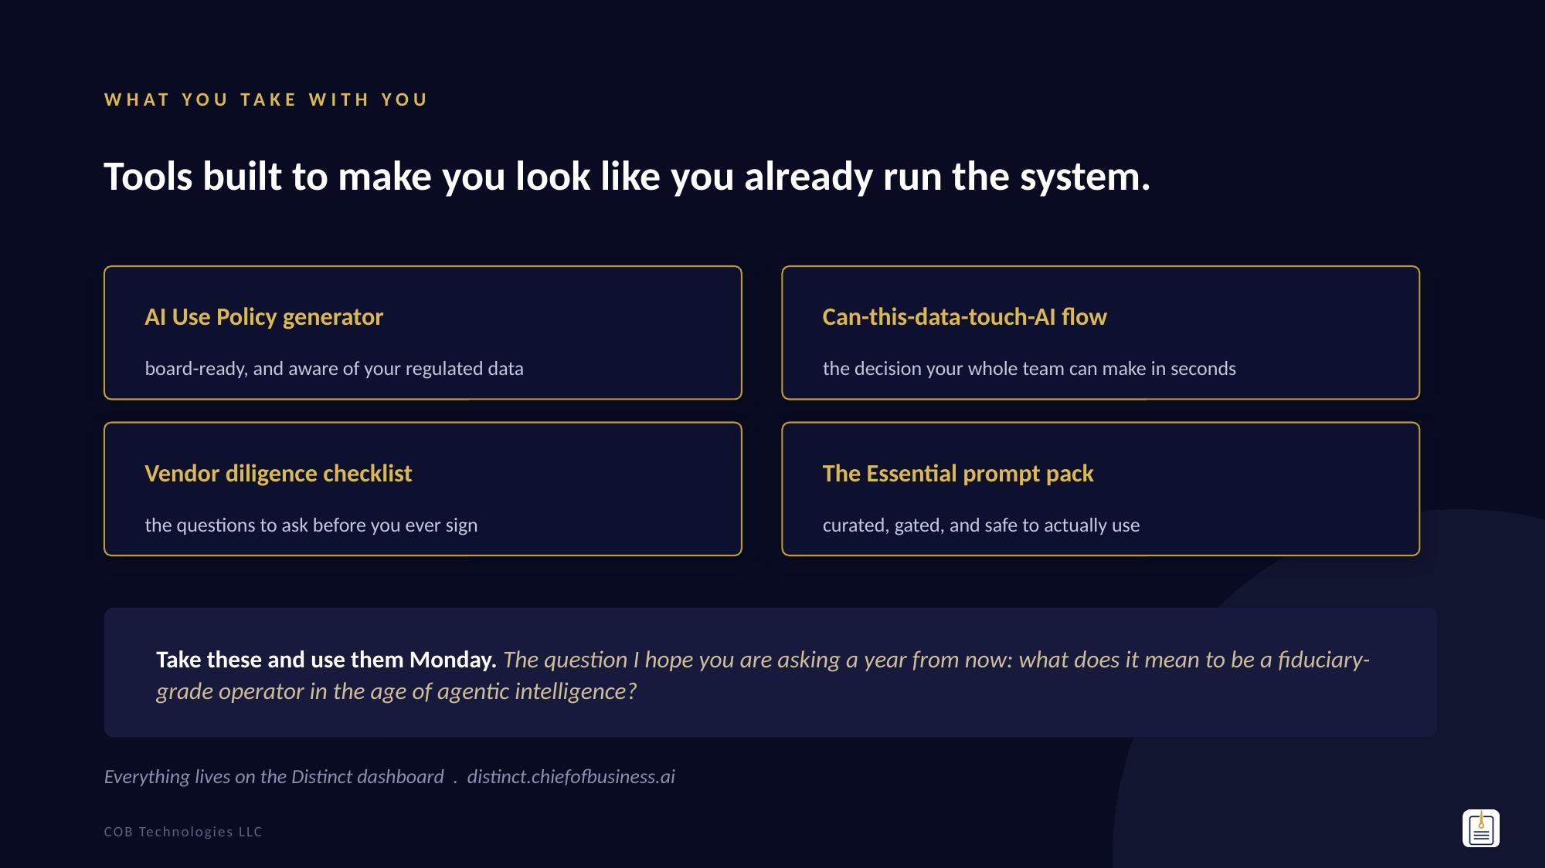
Notes:
Close with a gift and a question, not a call to action. Point them to the dashboard for the deliverables. The fiduciary-grade question is the line they repeat in the parking lot. Do not pitch. If the teaching served them, they will find you.
13

